Slide 1
Classification

Slide 2
Classification by Backpropagation
“What is backpropagation?” Backpropagation is a neural network learning algorithm.
Roughly speaking, a neural network is a set of connected input/output units in which each connection has a weight associated with it.
During the learning phase, the network learns by adjusting the weights so as to be able to predict the correct class label of the input tuples.
Neural network learning is also referred to as connectionist learning due to the connections between units.

Slide 3
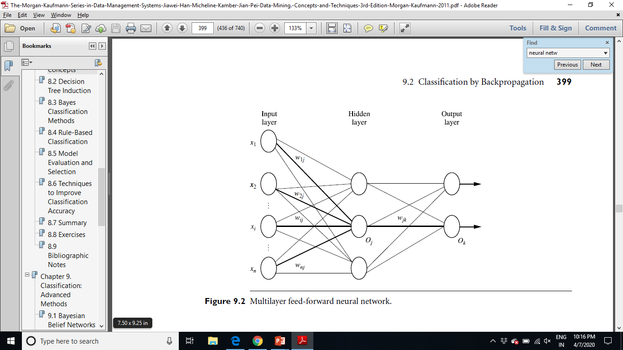

Slide 4
A Multilayer Feed-forward Neural Network
A multilayer feed-forward neural network consists of an input layer, one or more hidden layers, and an output layer.
Each layer is made up of units. The inputs to the network correspond to the attributes measured for each training tuple.
The inputs are fed simultaneously into the units making up the input layer.
These inputs pass through the input layer and are then weighted and fed simultaneously to a second layer of “neuronlike” units, known as a hidden layer.
The outputs of the hidden layer units can be input to another hidden layer, and so on. The number of hidden layers is arbitrary, although in practice, usually only one is used. The weighted outputs of the last hidden layer are input to units making up the output layer, which emits the network’s prediction for given tuples.
It is fully connected in that each unit provides input to each unit in the next forward layer.

